Slide 1
HomeAgent
UGREEN

Slide 2
Table of Contents
Introduction to UGREEN
Problem
Project implementation steps
Results/modifications

Slide 3
Who is UGREEN?

Slide 4
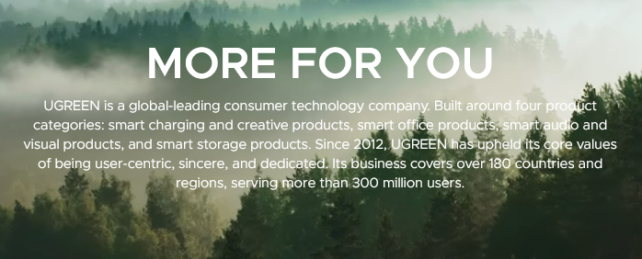
Who is UGREEN?
Chinese Company founded in 2012
Started off as a cable manufacturer
Leading providers in charging, connectivity solutions, and NAS systems

Slide 5
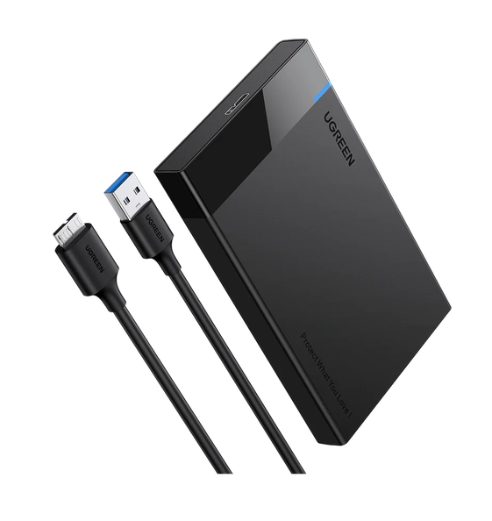
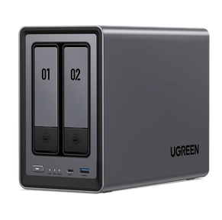
UGREEN, a company
UGREEN NASync DXP2800
UGREEN 2.5" Hard Drive Enclosure USB 3.0 to SATA III Adapter

Slide 6
What’s the problem?

Slide 7
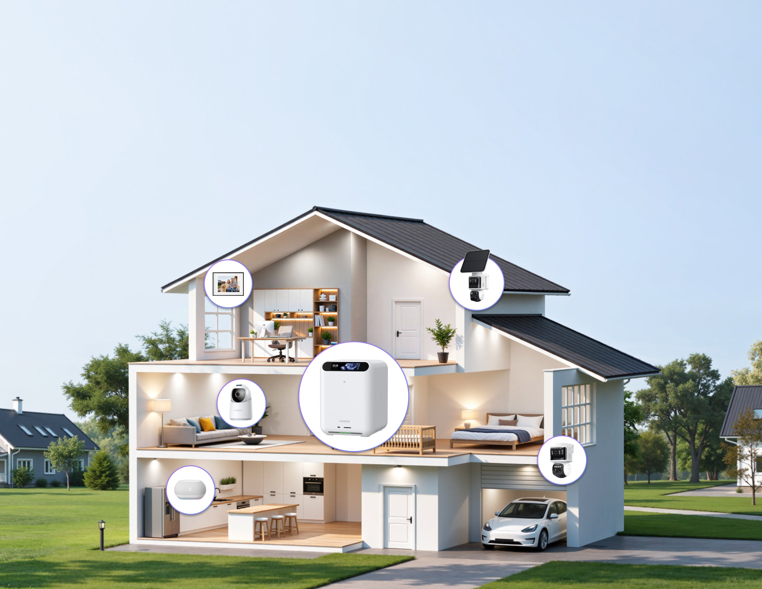
The problem
Finding a way to integrate and unifying IoT features into a single device
Security cameras → one application
Photos/files → NAS or cloud storage
Smart lights → another application
Voice assistant → another service
Home automation → another platform
AI processing → often cloud-based

Slide 8
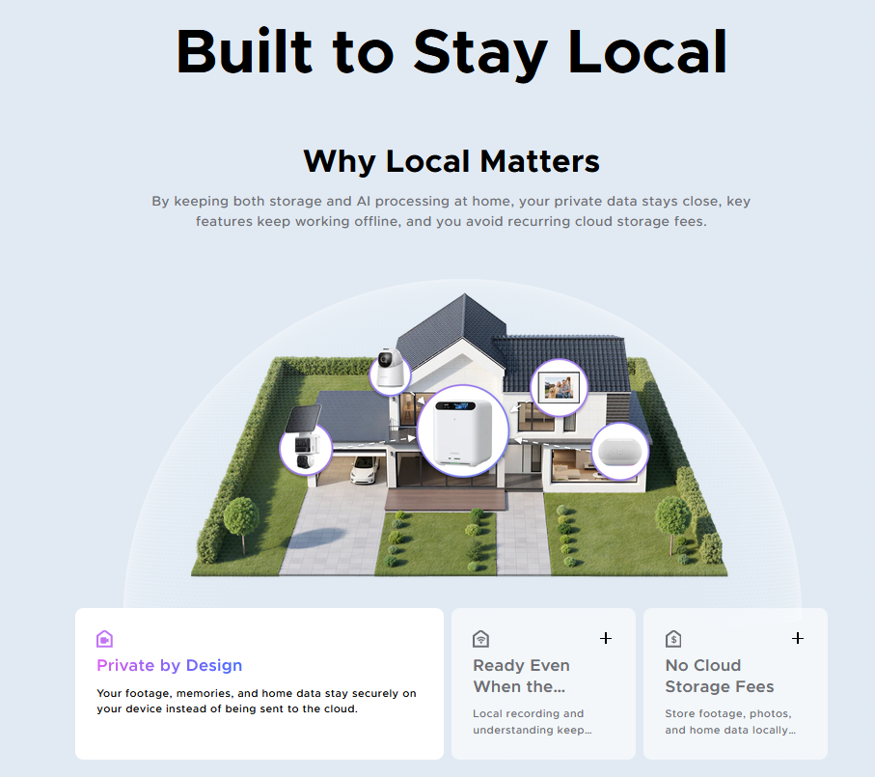
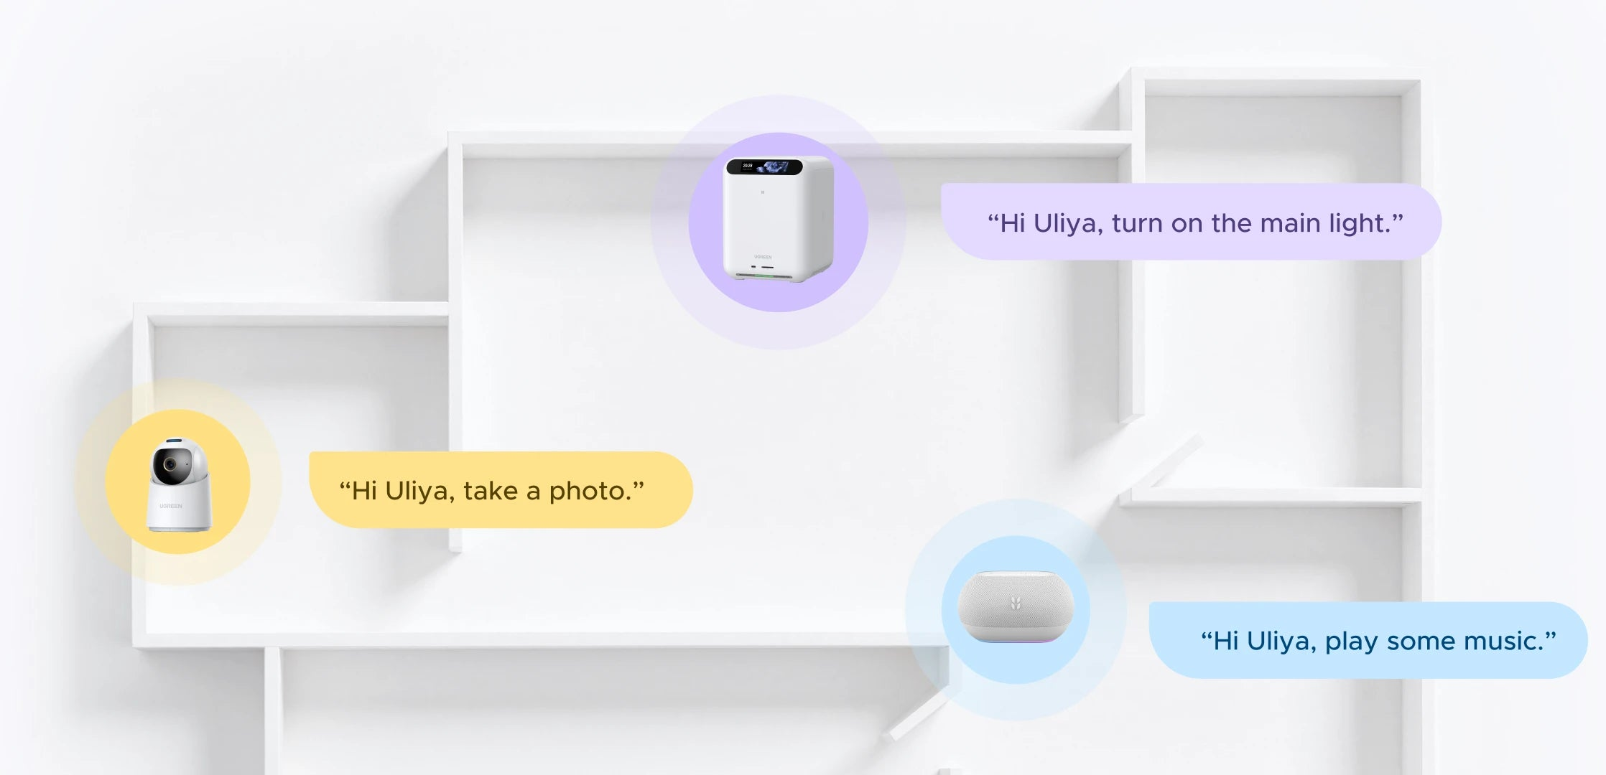
The problem (cont’d)
Context
Privacy

Slide 9
Implementation S

Slide 10
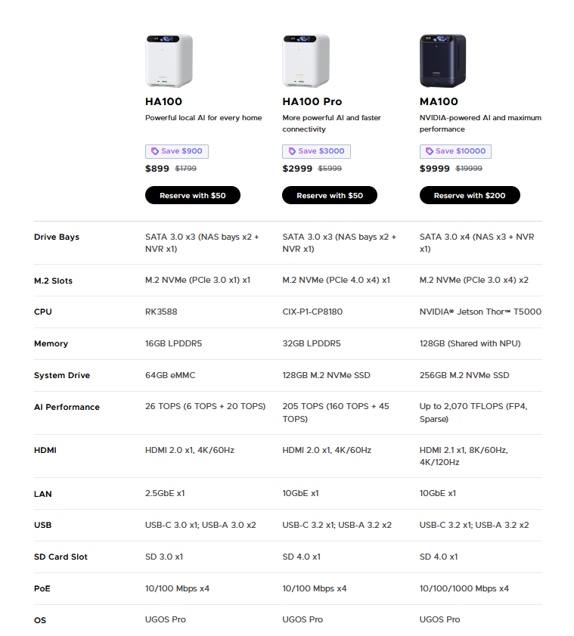
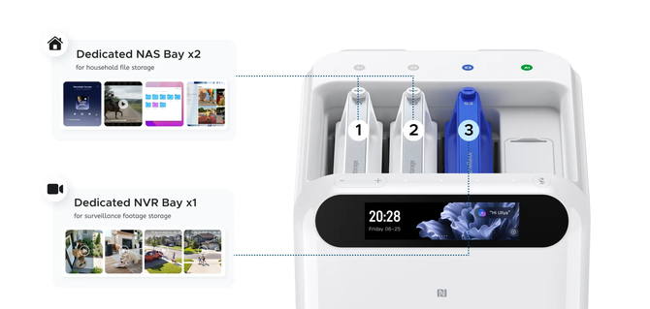
Hardware

Slide 11
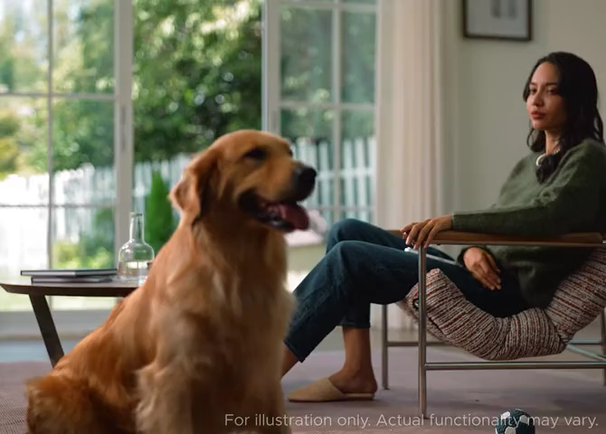
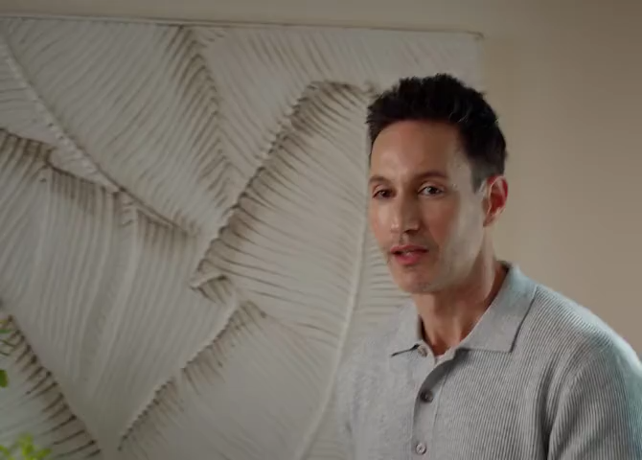
Local AI

Slide 12
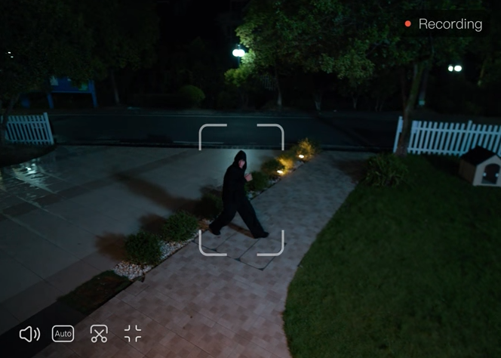
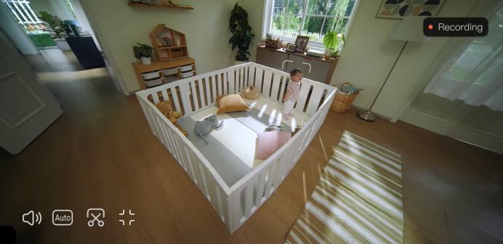
Local AI (cont’d)
New face detection
Crying baby alerts

Slide 13
Title and Content Layout with Chart

Slide 14
Two Content Layout with Table
First bullet point here
Second bullet point here
Third bullet point here
Class | Group A | Group B
Class 1 | 82 | 95
Class 2 | 76 | 88
Class 3 | 84 | 90

Slide 15
Two Content Layout with SmartArt
First bullet point here
Second bullet point here
Third bullet point here
Group A
Group B
Group C

Slide 16
Add a Slide Title - 1

Slide 17
Add a Slide Title - 2

Slide 19
Add a Slide Title - 4

Slide 20
Add a Slide Title - 5

